Slide 1
G2T1
Ticket Booking System
By: Eunice, Jia Xuan, Jolene, Kelly, Xiao Fang

Slide 2
Table of contents
01
02
03
04
05
06
Tech Stack
Design Principles
System Architecture
Demo
Conclusion
Open Source Libraries used
Notes:
Presentation delegation:
Design Principles (3 min) → A (xf)
System Architecture (5 min) →B,C (Jolene, Eunice)
Use the class diagram for the individual classes
Use the generic boxes for communication between the different classes (Use cases)
Customer make booking
TO make booking on behalf of the customer
EM cancel event
Customer cancel booking
Tech Stack (30 sec) → A (xf)
Open Source Libraries (30 sec) → A (xf)
Demo (10 min 30 sec) → D,E (Kelly, JX)
Conclusion (30 sec) → A (xf)
Slides:
Use the class diagram for the individual classes (Jia xuan)
Use the generic boxes for communication between the different classes (Use cases)
Customer make booking (Jolene)
TO make booking on behalf of the customer (Kelly)
EM cancel event (Xf)
Customer cancel booking (Eunice)

Slide 3

01
Design Principles

Slide 4
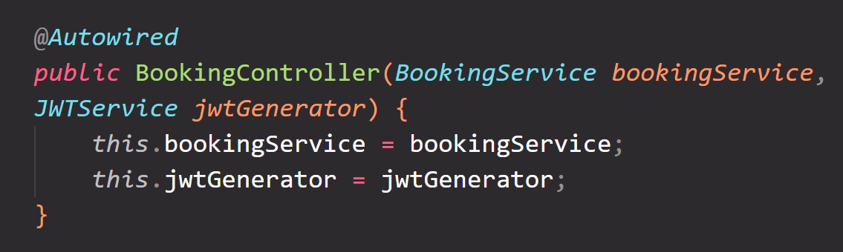
Inversion of Control (IoC)
Designed to receive its dependencies from an external source, rather than creating them itself
Dependency injection (DI):
Instead of classes creating their dependencies, dependencies are "injected" into classes by an external entity, in this case Spring.
@Autowired annotation
Notes:
Objects define their dependencies (that is, the other objects they work with) only through constructor arguments, arguments to a factory method, or properties that are set on the object instance after it is constructed or returned from a factory method
For the first design principle, we implemented Inversion of Control, or IoC. It's a principle where classes receive dependencies from an external source rather than creating them. In the Spring framework, we use annotations like @Autowired to inject these dependencies, making our code more modular and testable.

Slide 5
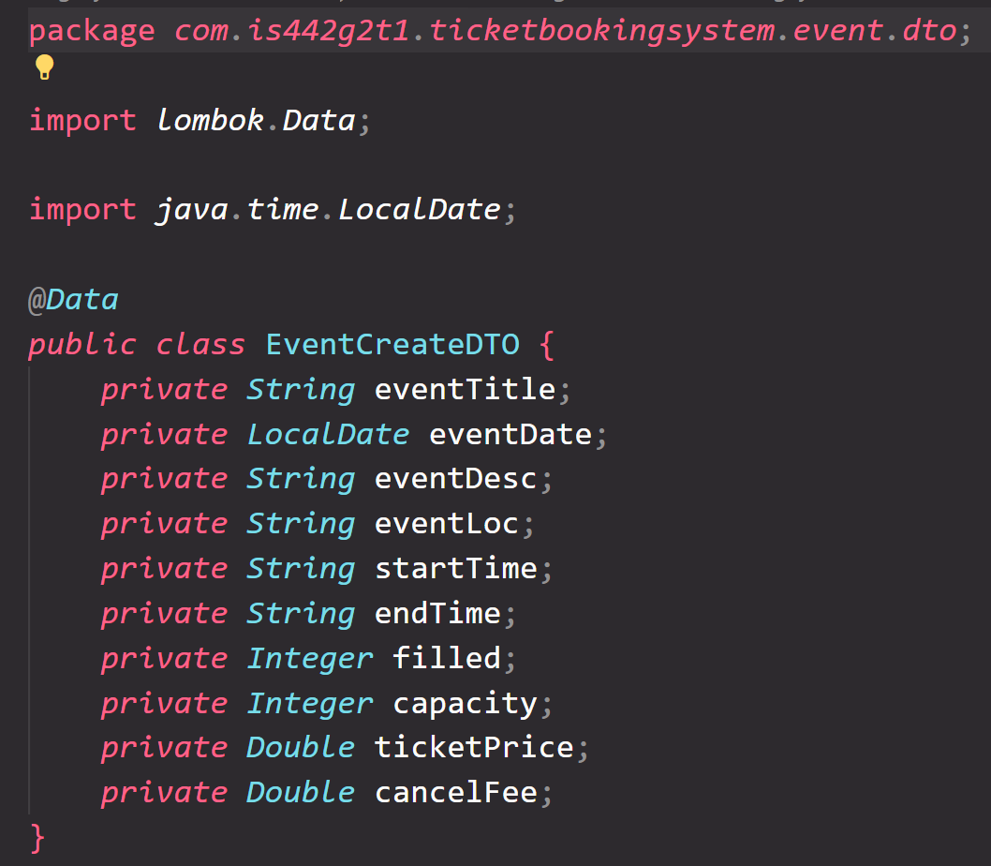
Data Transfer Object
For exchange of data between the business logic layer and the presentation layer.
Ensure clean separation between the data transfer and business logic
Goal: To reduce the number of method calls between these layers by aggregating data into a single object.
The service layer communicates with the controller using DTOs
Notes:
Next is Data Transfer Objects, or DTO. this is to facilitate the transfer of data between layers—like from business logic to presentation. They streamline communication by bundling data into one object, reducing the back-and-forth and keeping our code clean.

Slide 6
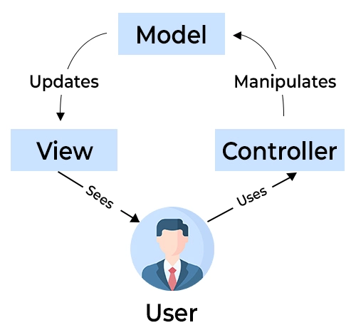
Other design principles
Single Responsibility Principle: Each class or method should perform one specific task or function
Separation of Concerns: Its MVC pattern separates concerns related to presentation (View), business logic (Model), and request handling (Controller)
Notes:
Lastly, the Single Responsibility Principle and Separation of Concerns keep our codebase organized and scalable. This is because each class handles one task, and MVC separates the app into Model, View, and Controller. This clear division allows for easier maintenance and updates.

Slide 7
02
System Architecture
Notes:
Add link to draw Io in the files
Use the class diagram for the individual classes
Use the generic boxes for communication between the different classes (Use cases)
Customer make booking
TO make booking on behalf of the customer
EM cancel event
Customer cancel booking
EM view sales statistics
TO verify the ticket

Slide 8


MVC Architecture
View
Define display (UI)
E.g. User clicks on “View Event”
User interacts with View
Updates content in View
Sends input from user
Render the content
Model
Defines data structure
E.g. Updates application to reflect event information
Controller
Contains control logic
E.g. Receives update from View, then notifies Model to retrieve event
Manipulates
Retrieve data from DB
Notes:
We followed the MVC architecture, where the User interacts with the View, and the View send requests to the controller, and the controller renders the content in the View or Manipulates the Model to interact with the database. The Model then updates the content in View

Slide 9
Classes
User
Event
Booking
Ticket
Token
Payment
Security
Email
Notes:
check if event need also

Slide 10
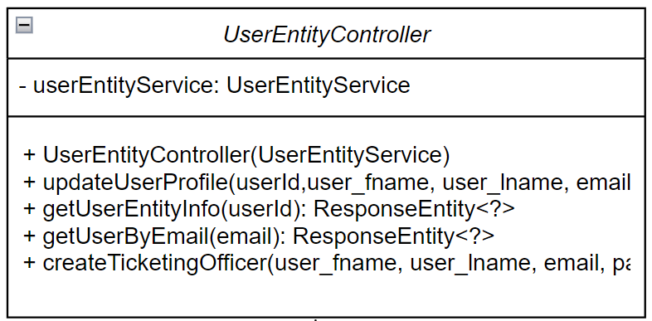
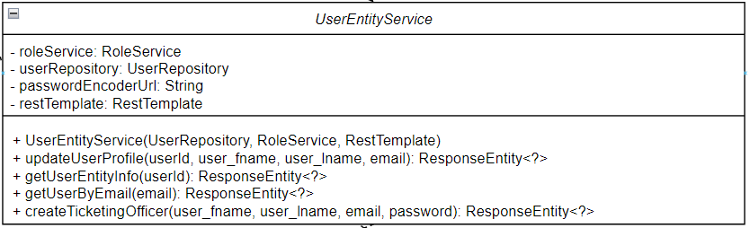
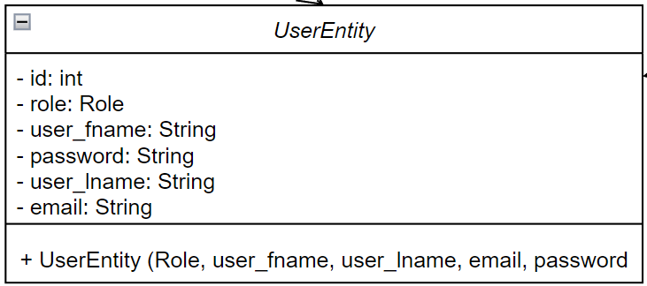
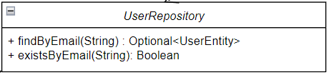
User
Notes:
For example, this is the User class diagram using the MVC framework, consisting of UserEntity Controller, service, repository and the UserEntity class itself

Slide 11
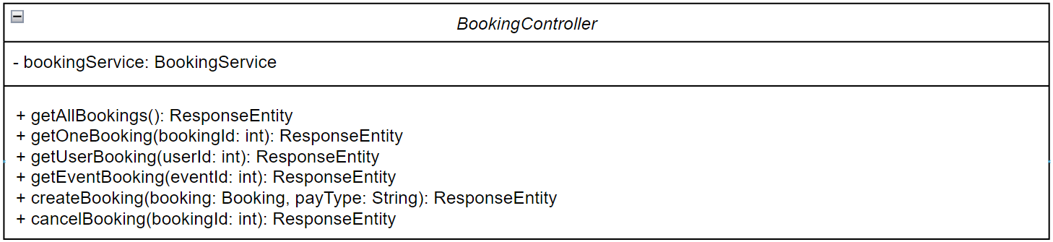
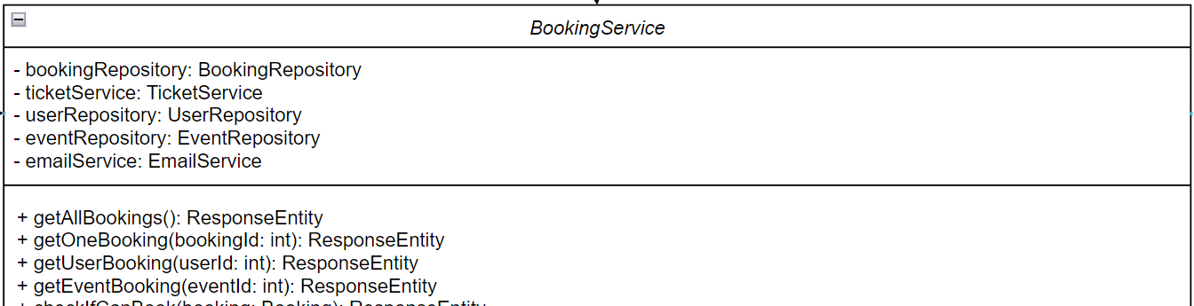
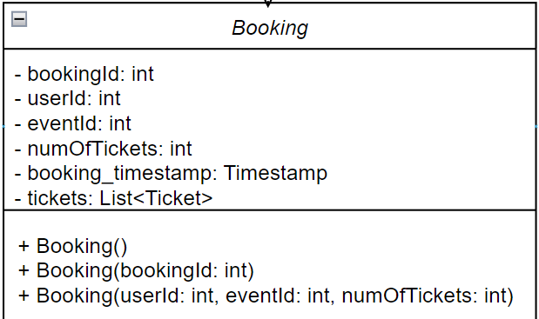
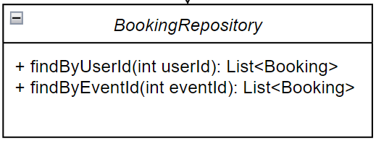
Booking
Notes:
Same goes for booking

Slide 12
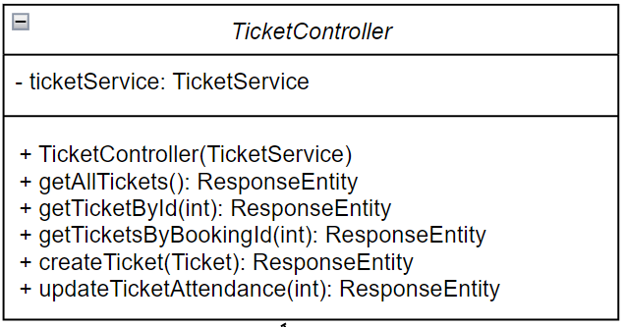
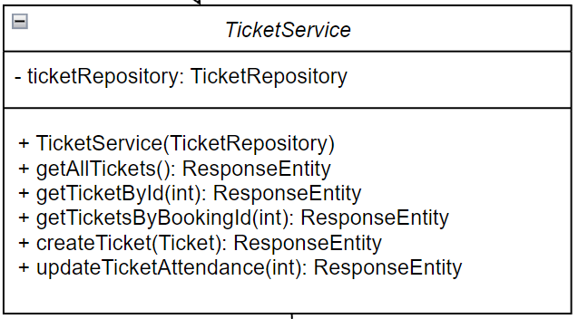
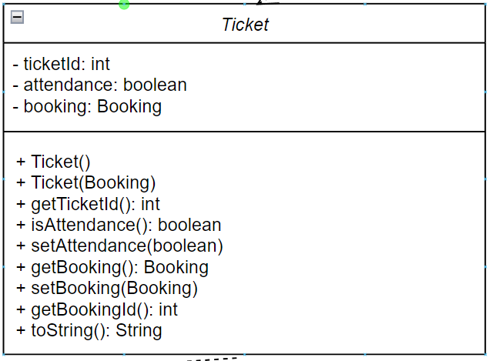
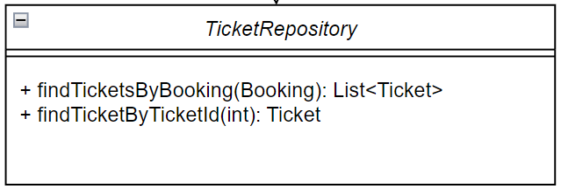
Ticket

Slide 13
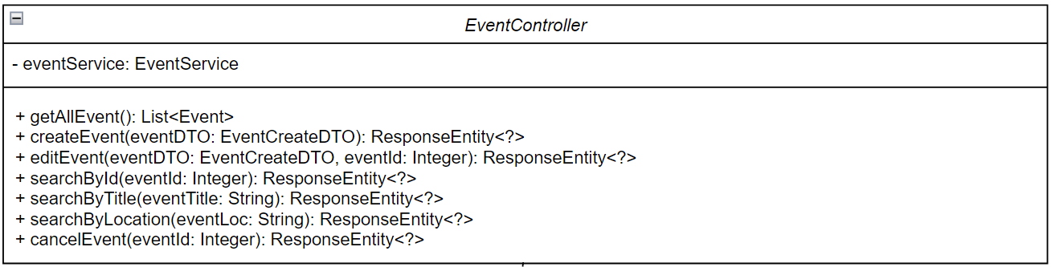
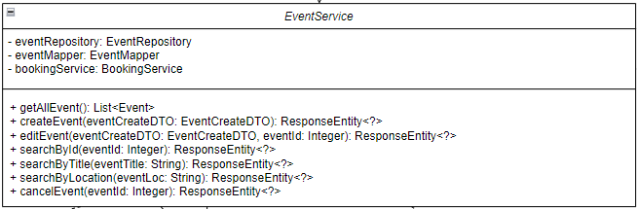
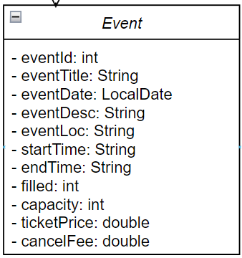
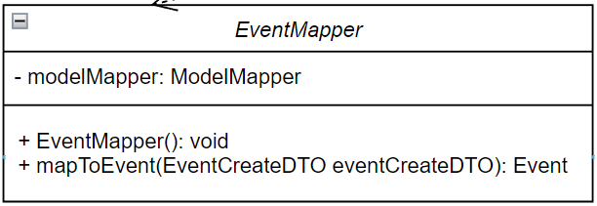
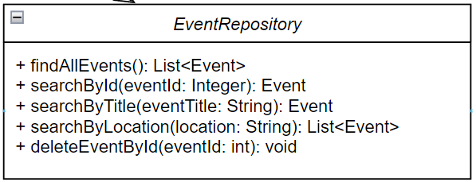
Event

Slide 14
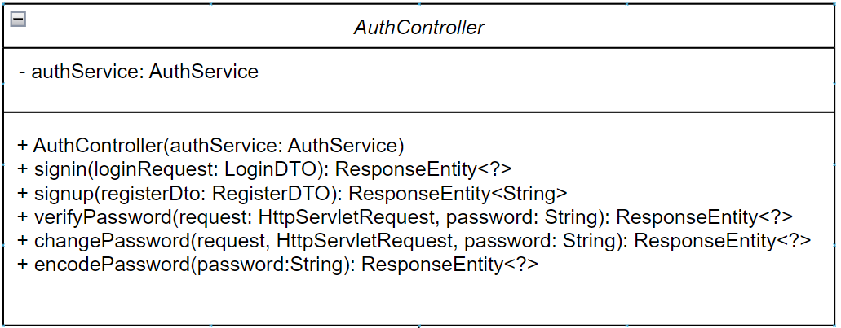
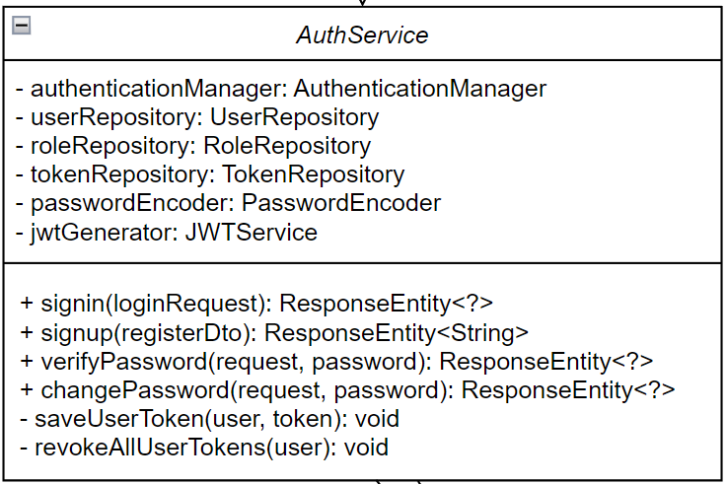
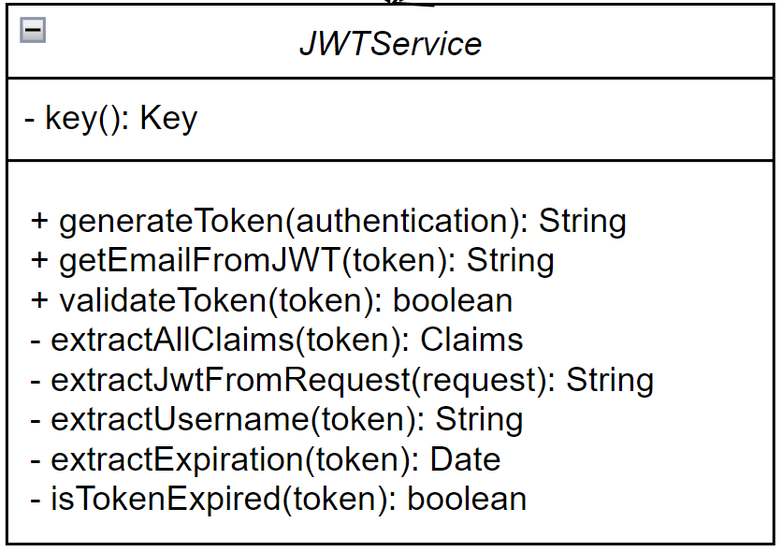
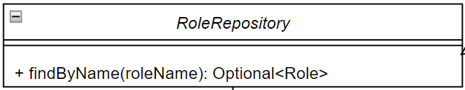
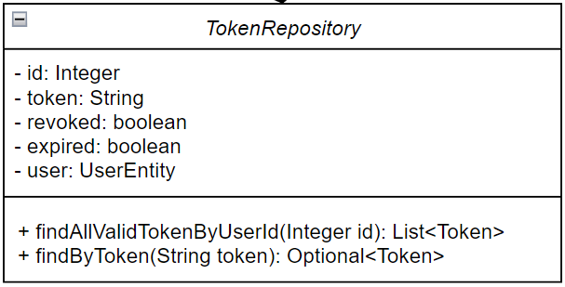
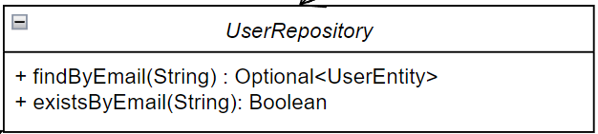
Authentication
Notes:
As for authentication, the authentication has a dependency relationship with AuthService, which in turn has dependency relationships with role User Token Reopsitory and JWTservice

Slide 15
User
User
Extends
Customer
Ticketing Officer
Event Manager
Notes:
For the class disgrams, for user class, we have roles like customer, ticketing officer and event manager that extends to user, Parent child rs

Slide 16
Booking
Event
User
Email
depends on
Ticket
Booking
has-a
Notes:
Booking has an association relationship with ticket

Slide 17
Ticket
Booking
depends on
Ticket

Slide 18
Security
JSON Web Token
Spring Security
<<interface>>
Authentication Entry Point
depends on
implements
Once Per Request Filter
Security
User Details
extends
User Details Service

Slide 19
Token
User
Security
has-a
depends on
Token
Notes:
User has an association relationship with token and token depends on security

Slide 20
Main Use Cases
01
02
03
04
Booking
Booking
Cancel
Cancel
Customer makes a booking
Ticketing Officer makes a booking on behalf of customer
Event Manager cancelling an event
Customer cancelling a booking
Notes:
Next, we will be going through communication diagrams for our 4 main use cases.
Slides:
Use the class diagram for the individual classes (Jia xuan)
Use the generic boxes for communication between the different classes (Use cases)
Customer make booking (Jolene)
TO make booking on behalf of the customer (Kelly)
EM cancel event (Xf)
Customer cancel booking (Eunice)

Slide 21
Create Booking
User
Booking
1. Check the users role
Customer
2. If Ticketing officer
Home page
Checkout Form Ticketing Officer
3.booking/new/{payType}
payType == “ewallet” or
payType == “stripe”
2. If User is Customer
Ticketing Officer
Checkout Form (Customers)
Notes:
User enters the form clicks on purchase
The backend will then check if they are allowed to book (Booking controller and booking service)
Return ResponseEntity.ok or IllegalArgumentException if event not found
Interacts with the UserEntity controller to get user info from userId
Based on the role from the above, direct to the correct page – TO and pass them the user Information and the numofTickets bought, eventId. Directed to the page CheckoutFormTicketingOfficer
Call the eventId page to fill up the information, takes in the eventId

Slide 22
Create Booking
1. Check if event capacity is full
/booking/new/{payType}
Booking
Event
3. Update event filled capacity
4. Save booking
2. Check if User is Customer and if ewallet whether has enough money
7. Send confirmation email
6. If payType is ewallet, deduct amount
User
5. Purchase tickets
Email
Ticket
#61c7d6
Notes:
Slides:
Use the class diagram for the individual classes (Jia xuan)
Use the generic boxes for communication between the different classes (Use cases)
Customer make booking (Jolene)
TO make booking on behalf of the customer (Kelly)
EM cancel event (Xf)
Customer cancel booking (Eunice)

Slide 23
Event Manager cancels an Event
1. Check if event exists
2. Get all bookings under event
/cancelEvent/{eventId}
Event
Booking
7. Cancel Event
6. Cancel Booking
5. Send cancellation email
3. Refund into ewallet
Email
4. Delete tickets
User
Ticket
Notes:
Slides:
Use the class diagram for the individual classes (Jia xuan)
Use the generic boxes for communication between the different classes (Use cases)
Customer make booking (Jolene)
TO make booking on behalf of the customer (Kelly)
EM cancel event (Xf)
Customer cancel booking (Eunice)

Slide 24
Customer cancels Booking
1. Check if Booking exists
2. Check if User is Customer
/delete/{bookingId}
Booking
User
7. Cancel booking
5. Refund into ewallet
3. Update event filled capacity
6. Send cancellation email
4. Delete tickets
Event
Email
#61c7d6
Ticket
Notes:
Slides:
Use the class diagram for the individual classes (Jia xuan)
Use the generic boxes for communication between the different classes (Use cases)
Customer make booking (Jolene)
TO make booking on behalf of the customer (Kelly)
EM cancel event (Xf)
Customer cancel booking (Eunice)

Slide 25
03
Tech Stack

Slide 26




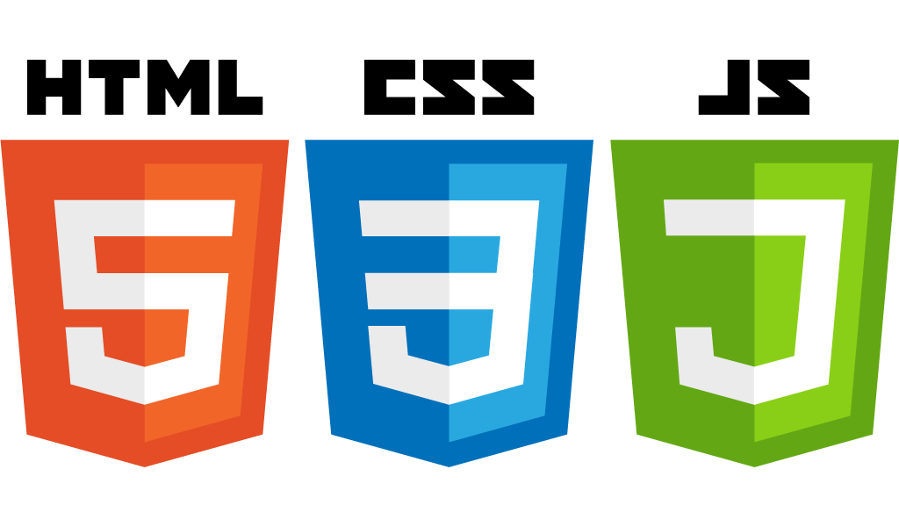
Tech Stack
1
2
3
Frontend
Backend
Databases
Vue/Vuetify
SpringBoot
MySQL

Slide 27
04
Open-Source Libraries

Slide 28





Open-source libraries
Spring Boot Starter Web
Spring Security
Spring Boot Starter Mail
Starter for building RESTful applications using Spring MVC
For Authentication & Authorization, Verification for wallet payment
Easily configure and send emails
Vue-Router
Stripe
Axios
For client-side routing in Vue.js applications
For secure payment
For making HTTP requests from the client-side in Vue.js applications
Notes:
We leverage on these open-source libraries for both front-end and back-end development.
Spring Boot Starter Web and Spring Security form the backbone of our RESTful services and security protocols such as authentication and payment.
Spring Boot Starter Mail manages our email sending capabilities, while Axios facilitates client-side HTTP requests.
For front-end routing in Vue.js, we use Vue-Router.
And finally Stripe handles our secure payment processing.

Slide 29
05
Demo
Notes:
Customer sign up → jxchin.2021@scis.smu.edu.sg
Customer log in
Customer to view the home page (upcoming event & current event)
Click on both to show the difference (One can buy & one cant)
Customer purchase ticket
Customer check my booking (to see that booking is there)
Customer cancel the booking
Show the email
Customer view past bookings
Customer to update profile
Customer to update password → to show that it is encoded, move to the database
Customer wallet balance
Customer log out
Event manager log in
Event manager create event
Event manager view events
Event manager edit events
Event manager cancel the events → to show its gone, look at the view events page
Show the email of the customer
Event manager view statistics and downloads the stats
Event manager add Ticketing officer → to show that it is added, look at the database
Event manager log out
Ticketing officer logs in (with the Ticketing Officer that EM created)
Ticketing officer verify the ticket validity → Look at the frontend text
Ticketing officer books on behalf of the customer
Show that the email is sent to customer → Open email

Slide 30
06
Conclusion

Slide 31
How the work was split
Eunice
Jia Xuan
Jolene
Event Class
Email Class
Booking Class
Ticket Class
Security
Payment Class
Payment frontend
Kelly
Xiao Fang
User Classes Frontend
User Classes Frontend

Slide 32
Links
Github repository:
https://github.com/jiaxuanchin/is442-g2t1/tree/main
UML Class Diagram:
https://drive.google.com/file/d/1rUWqpN9eBMf5bd-XzG5HqFUySRj6dYRl/view?usp=sharing

Slide 33
Thank You!
IS442 G2 T1

